Slide 1

QUARANTEAM
Using Machine Learning in Cancer Diagnosis
Aliona Mizelle
Michelle Fitzpatrick
Kate Vnuk
Joao Costa
Vitor Ribeiro

Slide 2
Datasets and Approach
Analysis of Results
Learning in the Process

Slide 3
Datasets and Approach
Analysis of Results
Learning in the Process

Slide 4
Descriptive Dataset
https://www.kaggle.com/uciml/breast-cancer-wisconsin-data
Contains descriptive information collected using fine needle aspiration (FNA) from different breast masses. Includes characteristics of cell nuclei as well as diagnostic results.
Images Dataset
https://www.kaggle.com/paultimothymooney/breast-histopathology-images
Contains a collection of cell images (~277,000) of Invasive Ductal Carcinoma (IDC) and Non-IDC in anonymized patients.

Slide 5
Approach
Use Machine Learning techniques to determine which method achieves the greatest accuracy and which type of data is more reliable in diagnosis.
Descriptive Dataset
Images Dataset
Run data through a variety of machine learning techniques and rank them in terms of accuracy.
Pass images through a neural network at different configurations to improve accuracy.

Slide 6
Datasets and Approach
Analysis of Results
Learning in the Process

Slide 7
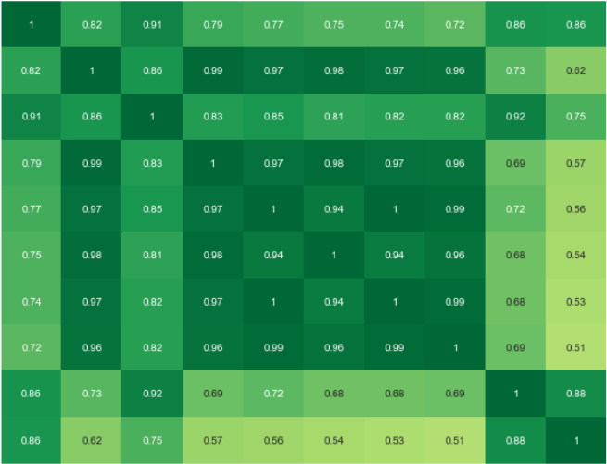
Descriptive Dataset – EDA and Feature Selection
==== Top 10 Features ====
concave points_worst
1.00
perimeter_worst
Total Tumors in dataset = 569
Total Benign Tumors in dataset = 357
Total Malignant Tumors in dataset = 212
Percent Benign = 62.74%
Percent Malignant = 37.26%
concave points_mean
radius_worst
perimeter_mean
area_worst
radius_mean
area_mean
concavity_mean
-0.50
concavity_worst
perimeter_worst
radius_worst
area_worst
radius_mean
area_mean
concave points_worst
perimeter_mean
concavity_mean
concave points_mean
concavity_worst

Slide 8
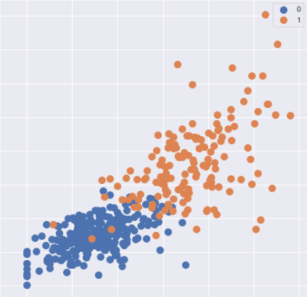
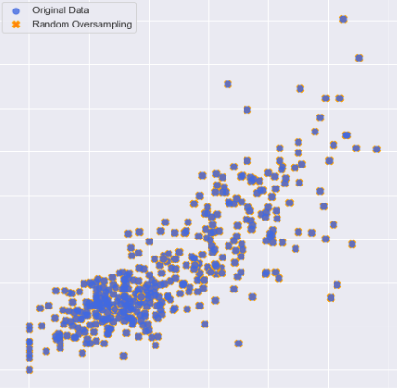
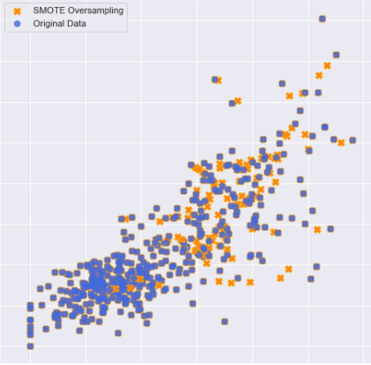
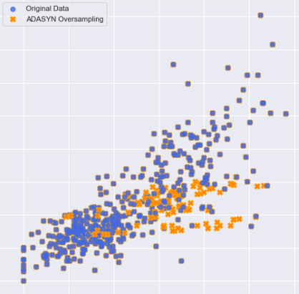
Descriptive Dataset – Oversampling Training Data
Before Oversampling
Random Oversampling
250
250
Total Tumors in training data = 398
Total Benign Tumors in training data = 250
Total Malignant Tumors in training data = 148
50
50
0
0.30
0
0.30
SMOTE Oversampling
ADASYN Oversampling
250
250
50
50
0
0.30
0
0.30

Slide 9

Descriptive Dataset – Results of Each Model
Logistic Regression Model - Accuracy: 0.930 (+/- 0.029)
Miss-classified data index [347, 13, 476, 508, 421, 152, 385, 491, 213, 414, 40, 484]
SVC Model - Accuracy: 0.936 (+/- 0.033)
Miss-classified data index [13, 242, 476, 421, 152, 385, 126, 489, 414, 40, 484]
Neural Network Model - Accuracy: 0.936 (+/- 0.033)
Miss-classified data index [13, 421, 119, 385, 491, 489, 414, 209, 40, 484]
Random Forest Model - Accuracy: 0.942 (+/- 0.026)
Miss-classified data index [13, 476, 385, 536, 126, 491, 414, 209, 40, 484]
Gradient Boosting Model - Accuracy: 0.924 (+/- 0.023)
Miss-classified data index [13, 476, 152, 385, 126, 491, 489, 91, 213, 414, 209, 40, 469, 484]
Combining Models in an Ensemble Vote Classifier
Ensemble Model – Accuracy 95.906%

Slide 10
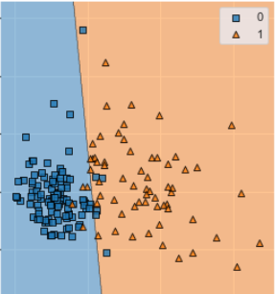
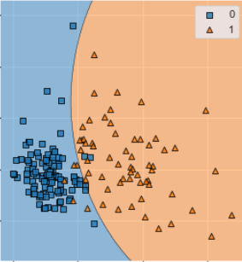
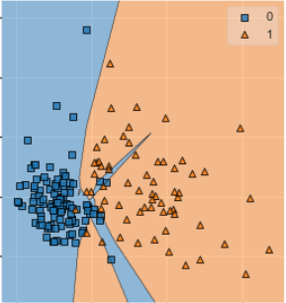
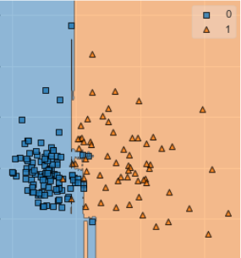
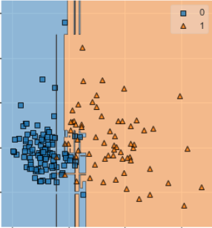
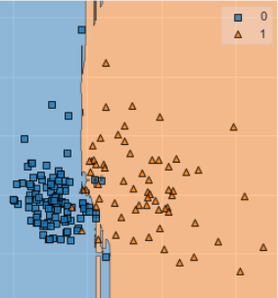
Descriptive Dataset – Visualizing Results
Logistic Regression
SVC
Neural Network
6
6
6
0 – Benign
1 – Malignant
-2
-2
-2
-5
10
-5
10
-5
10
Random Forest
Gradient Boosting
Ensemble
6
6
6
-2
-2
-2
-5
10
-5
10
-5
10

Slide 11






Images Dataset – Image Samples
Non – IDC (No Cancer)
IDC (Cancer)

Slide 12
Images Dataset – Results
Analyzed in Grayscale
Layer Structure
1st Layer - 64
2nd Layer - 32
3rd Layer - 8
Number of Epochs - 3
Applied Stochastic Gradient Descent (SGD) to improve our modeling.
Neural Network
- Accuracy: 85.20%
- Loss: 0.41943401273091635

Slide 13
Datasets and Approach
Analysis of Results
Learning in the Process

Slide 14
Lessons Learned
1 – Which model is appropriate for my data?
2 – The order in which to set up the model. When should we oversample? At which point does oversampling occur? Should we maintain the 1-0 original balance?
3 – Neural Networks are indeed a black box.
4 – Never trust the description of the data you are downloading. A thorough EDA process can save a lot of time.
5 – More steps do not mean better results.
6 – Run your code through a small sample to prevent running out of memory.

Slide 15
The Work Continues
We are currently working on a video walkthrough of our code which will be on a website we have prepared for this project. All the information will be available on our GitHub accounts.
https://github.com/areselian
https://github.com/Fitzpatrickmn
https://github.com/katevnuk
https://github.com/jCosta16
https://github.com/VitorRibeiro324-lab

